Slide 1


Reinforcing Bar Couplers for Cryogenic Applications
Tested to -168°C/-270°F according to EN 14620-3 with cryogenic quality rods
Ideal para
LNG/LPG
tanques

Slide 2

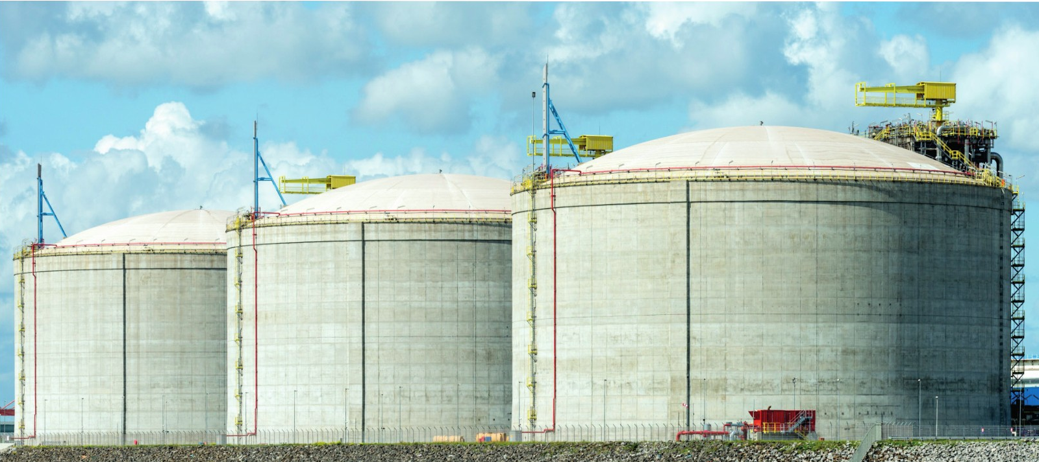
Cryogenic Rebar Couplers
The Ancon CTT tapered thread coupler range is designed for use with cryogenic-grade reinforcement in construction projects such as Liquefied Natural Gas (LNG) and Liquefied Petroleum Gas (LPG) tanks, according to EN 14620-3.
System Benefits
Structures according to EN 14620-3
Ancon CTT couplers are ideal for use in constructed structures.
In accordance with EN 14620-3:2006. This standard specifies the requirements for materials, design, and construction of all components of in-situ, vertical, cylindrical, and below-ground storage or refrigeration tanks for liquefied gases operating at temperatures between 0°C and –165°C. BS EN 14620-3:2006 superseded BS 7777-3:1993.
3
Suitable for use on structures according to EN 14620-3
Tested with quality reinforcing bars and cryogenic environment at temperatures of (-168°C/-270°F)
Compact design coupler for use in confined spaces
3
3
CRYOGENIC quality rods
Kryba®r specializes in cryogenic concrete reinforcement bars
KRYBAR-165 bars are suitable for storage tanks operating at temperatures below -170°C/-274°F, and these were the cryogenic-grade bars used in the ANCON testing program.
3 The tapered thread simplifies rod placement and alignment.
The CTT Range
The Ancon range includes standard, positional, and transition couplers.
For rods with diameters ranging from 12 to 32 mm. In all cases, the rod ends are cut before being tapered to tighten onto the threaded coupler. The coupler is simply tightened onto the bar at the threaded end using a torque wrench.
3
Very quick and easy installation, to promote construction speed.
Reference
LNG Reservoir, Yamal, Russia
The Yamal LNG project is located in the Ob River estuary in northeastern Russia, which is frozen nine months a year.
The tank has a capacity of 160,000 m3 and encloses a stainless steel container and an external pre-stressed concrete structure; this is composed of more than 16,000 Ancon cryogenic couplers for connecting Krybar rods ranging in diameter from 25 to 32 m.

Slide 3
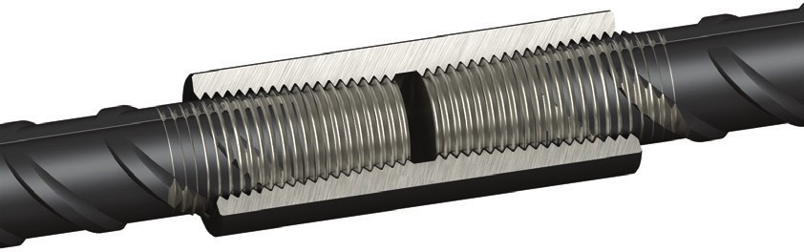
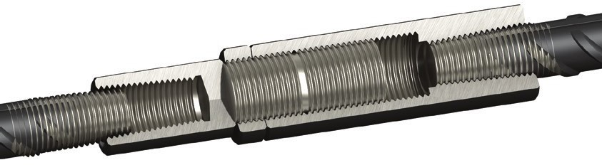
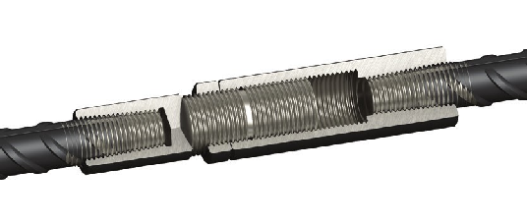
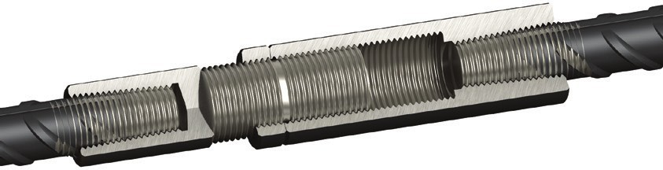
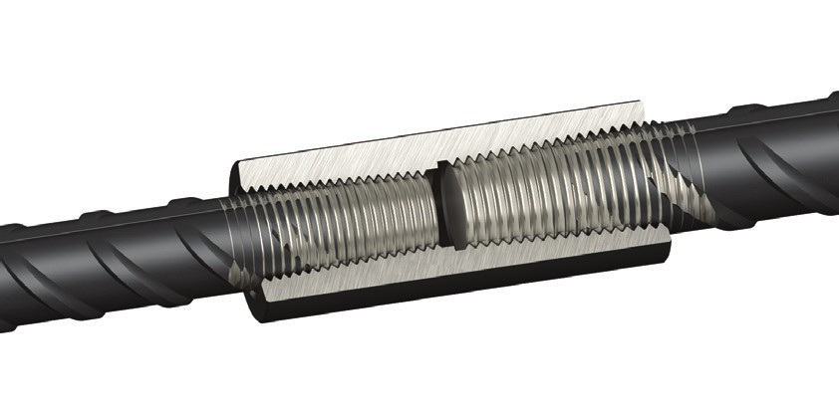
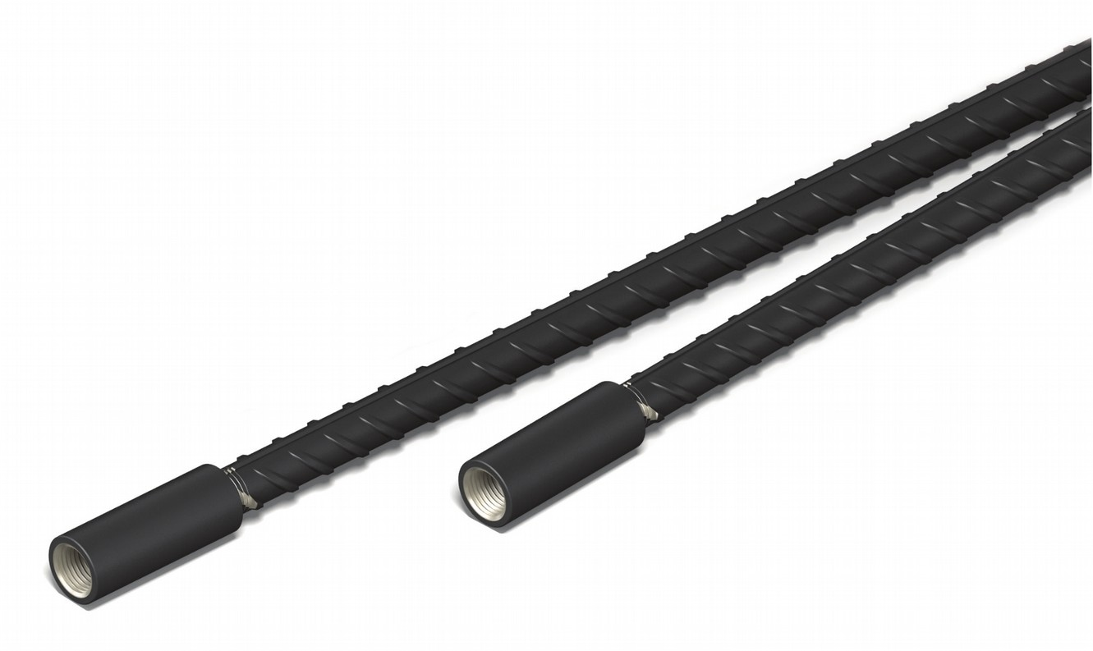
Standard Cryogenic Couplers (CTTS)
Ancon Cryogenic Tapered Thread Couplers are used to connect two rods of the same diameter, when one of the rods can be rotated.
l
d
Rod diameter (mm) |  | 12 | 14 | 16 | 20 | 25 | 28 | 32
External diameter (mm) | d | 22 | 22 | 25 | 30 | 36 | 42 | 48
Coupler length (mm) | l | 58 | 64 | 70 | 74 | 90 | 100 | 112
Peso (kg) |  | 0.13 | 0.12 | 0.17 | 0.25 | 0.43 | 0.66 | 0.99
Torque (Nm) |  | 60 | 85 | 110 | 165 | 265 | 275 | 285
Ref.
CTTS12 CTTS14 CTTS16 CTTS20 CTTS25 CTTS28 CTTS32
lc
d1
Cryogenic Positional Couplers (CTTP)
Ancon's cryogenic tapered thread positional couplers are used when neither bar can be rotated. They consist of a male section, a female section, and a locking nut. Adjustable, they can be used to bring two rebars together.
d2
li
Female Component Locking Nut
Male Component
ls
le
Rod diameter (mm) |  | 12 | 14 | 16 | 20 | 25 | 28 | 32
External Diameter (mm) | d1 | 25 | 25 | 30 | 36 | 48 | 50 | 55
External Diameter (mm) | d2 | 22 | 22 | 25 | 30 | 36 | 42 | 48
Female length (mm) | ls | 84 | 89 | 95 | 112 | 132 | 137 | 153
Nut length (mm) | ln | 13 | 13 | 13 | 13 | 13 | 13 | 15
Closed length (mm) | lc | 138 | 150 | 155 | 180 | 207 | 218 | 243
Max. Open Length (mm) | lo | 178 | 190 | 196 | 231 | 266 | 274 | 305
Insert rod before tightening (mm) | li | 9 | 12 | 15 | 8 | 16 | 22 | 28
Rod insertion after tightening (mm) | le | 26 | 29 | 32 | 33 | 42 | 47 | 53
Adjustable length (mm) | la | 23 | 23 | 24 | 26 | 34 | 34 | 37
Max distance between rods (mm) | lm | 126 | 124 | 132 | 165 | 182 | 174 | 199
Weight (kg) |  | 0.44 | 0.67 | 0.67 | 1.12 | 2.21 | 2.30 | 3.51
Coupler Torque (Nm) |  | 60 | 85 | 110 | 165 | 265 | 275 | 285
Nut Torque (Nm) |  | 20 | 25 | 30 | 50 | 70 | 80 | 90
la
In
lm
Ref.
CTTP12 CTTP14 CTTP16 CTTP20 CTTP25 CTTP28 CTTP32
lo
Cryogenic Transition Couplers (CTTT)
Ancon cryogenic threaded taper transition couplers are used to join rods of different diameters, when one of the rods can be rotated.
d
l
ões
 |  |  |  |  |  |  |  | d
Rod diameter (mm) 12/14 | 12/16 | 14/16 | 16/20 | 20/25 | 25/28 | 25/32 | 28/32
External dia. (mm) d 22 | 25 | 25 | 30 | 36 | 42 | 48 | 48
Lenght (mm) l 65 | 72 | 71 | 78 | 90 | 99 | 112 | 110
Weight (kg) 0.14 | 0.21 | 0.19 | 0.30 | 0.48 | 0.72 | 1.11 | 1.02
Torque (Nm) 60/85 | 60/110 | 85/110 | 110/165 | 165/265 | 265/275 | 265/285 | 275/285
Ref.
CTTT12/14 CTTT12/16 CTTT14/16 CTTT16/20 CTTT20/25 CTTT25/28 CTTT25/32 CTTT28/32

Slide 4


Revendedor:
The construction applications and details provided in this literature are indicative only. In every case, project working details should be entrusted to appropriately qualified and experienced persons.
Whilst every care has been exercised in the preparation of this document to ensure that any advice, recommendations or information is accurate, no liability or responsibility of any kind is accepted in respect of Ancon Building Products.
With a policy of continuous product development Ancon Building Products reserves the right to modify product design and specification without due notice.
© Ancon Building Products 2015
Krybar is a registered trademark of Arcelor Mittal

